Slide 1
The Nervous System
Overview and Histology

Slide 2
Overview of the Nervous System
Objectives:
List the structure and basic functions of the nervous system
Describe the organization of the nervous system

Slide 3
Functions
Stimulate all movement
Receive sensory input
Store and integrate information
Maintain homeostasis

Slide 4
Nervous System Cells
Neurons:
carries the nerve impulses, mitosis not possible after reaching maturity
Neuroglial cells:
supports neurons, does not carry impulses, mitosis is possible throughout lifespan

Slide 5
Divisions of the Nervous System
Central Nervous System (CNS)
Brain and Spinal Cord
Peripheral Nervous System (PNS)
All nervous tissue outside the CNS

Slide 6
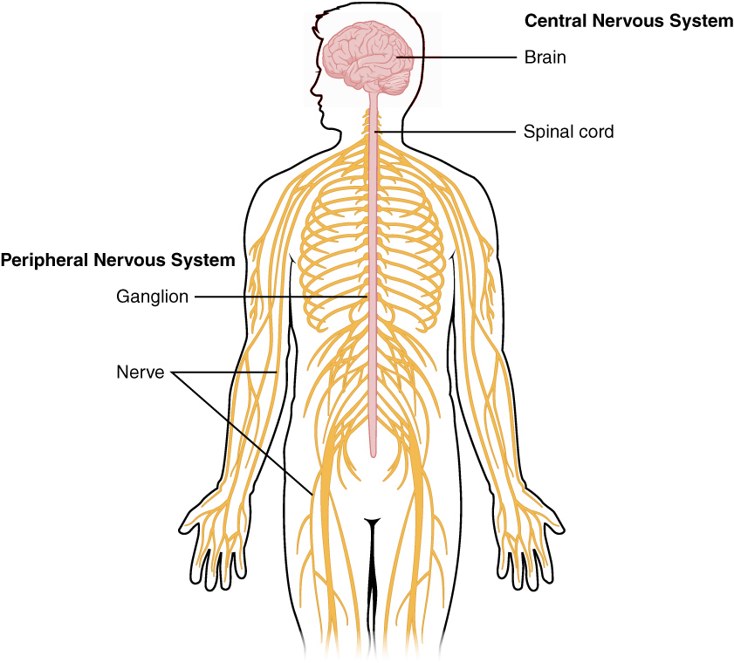

Slide 7
Structures of the Nervous System
Brain - composed of 100 billion nerves
Cranial Nerves - 12 pairs (I-XII) of nerves that emerge from the base of the brain
Nerve - bundle of axons and associated tissue and blood vessels

Slide 8
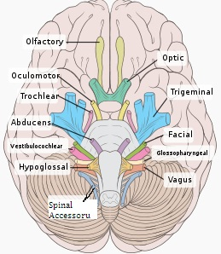

Slide 9
Structures of the Nervous System
Spinal Cord - Connects to the brain
Spinal Nerves - 31 pairs that emerge from the spinal cord
Ganglia - small masses of nervous tissue located outside the brain and spinal cord
Sensory Receptors - dendrites of sensory neurons or specialty cells that detect changes in the environment

Slide 10
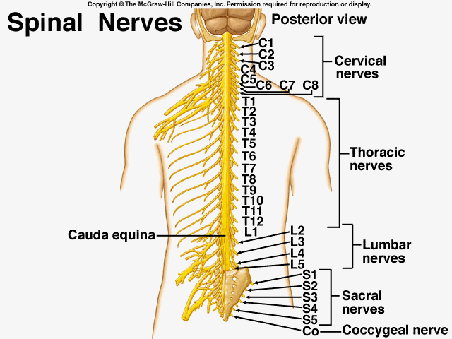
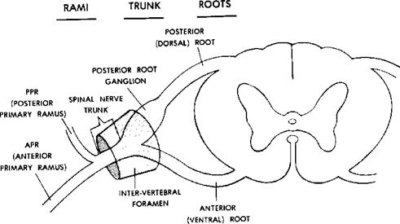

Slide 11
Functions of the Nervous System
Sensory Functions
Detect Stimuli
Carried by sensory or AFFERENT neurons
Integrative Functions
Process sensory information
Carried out by interneurons
Motor Functions
Respond to integrative decisions
Carried out by motor or EFFERENT neurons

Slide 12
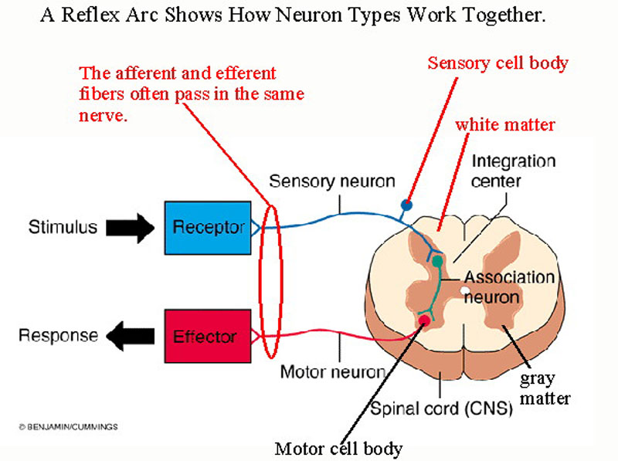

Slide 13
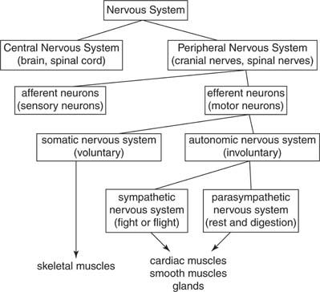
Organization of the Nervous System

Slide 14
Checkpoint Questions
1. What are the components of the CNS? of the PNS?
2. What are the 3 basic functions of the nervous system?
3. What does afferent mean? efferent?
4. Draw a chart illustrating the organization of the nervous system.

Slide 15
Neuroglial Cells
Most abundant in CNS
5 Major Types:
1. Microglial – phagocytes, protection
2. Oligodendrocytes – forms myelin in CNS
3. Astrocytes – provide support & connection between neurons and blood supply
4. Ependymal cells – lines cavities (Ventricles) of brain & spinal cord, helps form CSF, ciliated
5. Schwann cells – forms myelin in PNS

Slide 16
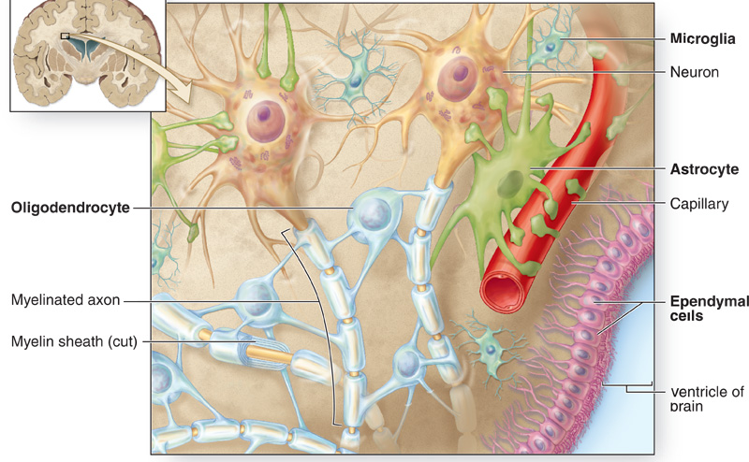
Can you find two neurons in this picture? What division of the NS is being shown here? What neuroglial cell is not shown here and why not?

Slide 17
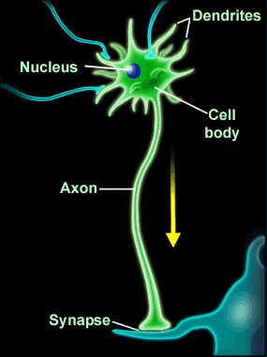
Neurons
Large in size
Very high metabolic rate
Amitotic (no replacing after destruction), no centrioles
Extreme longevity…over 100 yrs. possible
Cell structures:
- cell body, axon, dendrites, myelin sheath, nodes of Ranvier, nucleus, axon terminals, end bulbs, synapse
(If myelinated, will have Schwann cells or Oligodendrocytes attached to axon)

Slide 18
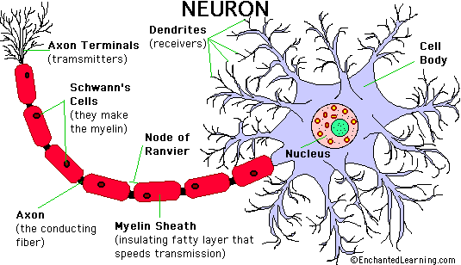
Basic Neuron Anatomy

Slide 19
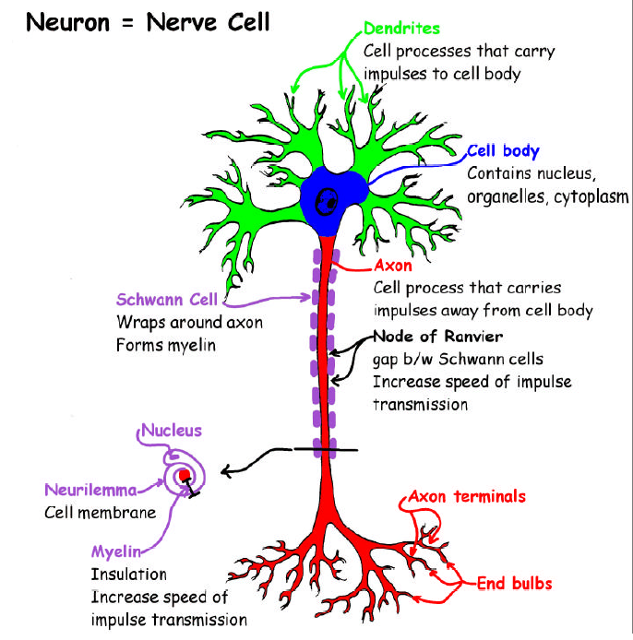
Impulses move along a one-way path!
Dendrites
Cell body
Axon

Slide 20
Neurons - continued
Axon Terminals - end branches of an axon
Synapse - the site where a neuron communicates with another cell
Synaptic end bulb - swollen tips of an axon terminal
Synaptic Vessicles - tiny sacs that store chemicals called neurotransmitters

Slide 21
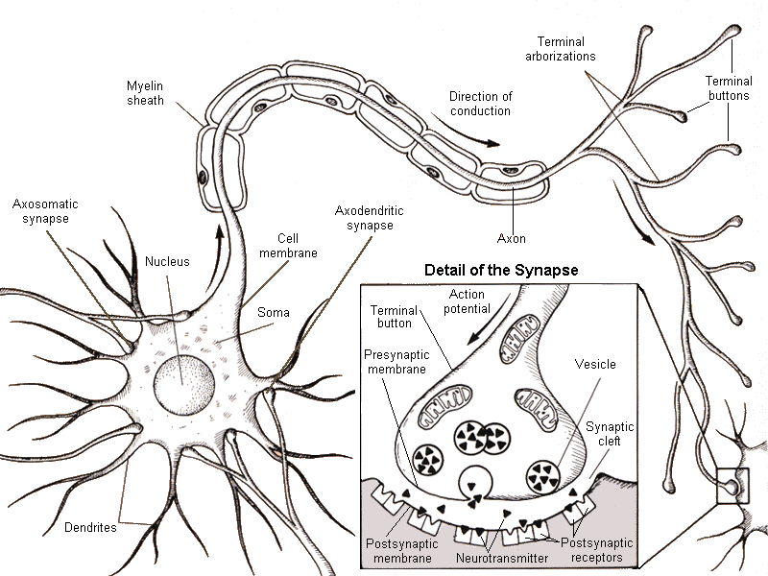

Slide 22
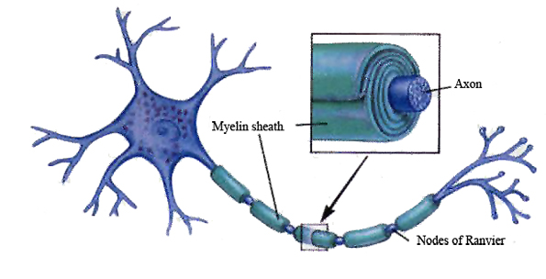

Slide 23
Histology of Nervous Tissue
Objectives
Contrast the characteristics and functions of neurons and neuroglia
Distinguish between gray matter and white matter

Slide 24
Cells found in Nervous Tissue
Neurons (nerve cells)
basic information-processing units
Neuroglia
support, nourish and protect the neurons

Slide 25
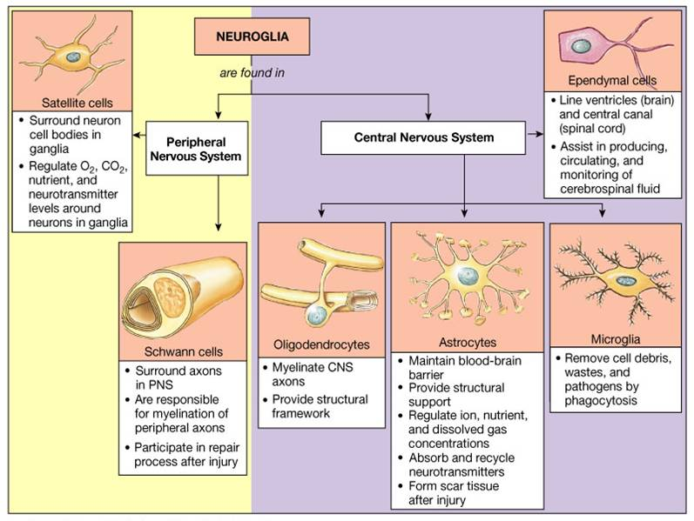
Neuroglia
6 types
Astrocytes
Oligodendrocytes
Microglia
Ependymal Cells
Schwann Cells
Satellite Cells

Slide 26
Myelination
Myelin Sheath
multi-layered covering composed of lipid and protein
insulates the axon of a neuron and increases speed of a nerve impulse
Produced by Schwann Cells (PNS) and Oligodendrocytes (CNS)
Nodes of Ranvier - gaps in the myelin sheath

Slide 27
Gray and White Matter
White Matter - consists of myelinated and unmyelinated axons of neurons
Gray Matter - consists cell bodies, dendrites, unmyelinated axons and axon terminals.

Slide 28
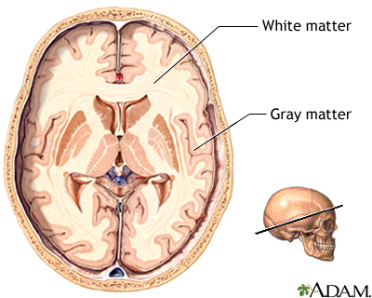
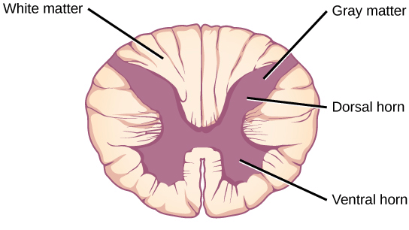

Slide 29
Check Point
What do Astrocytes do?
What does Myelin Do?
Neurons contain what 3 major parts?

Slide 30
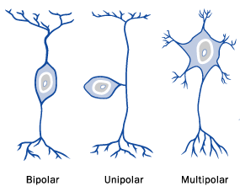
Neurons Structural Differences
1. Bipolar – rare, found in retina of eye
Unipolar – afferent (sensory) PNS
Multipolar – majority of all neurons; most in brain are multipolar.

Slide 31
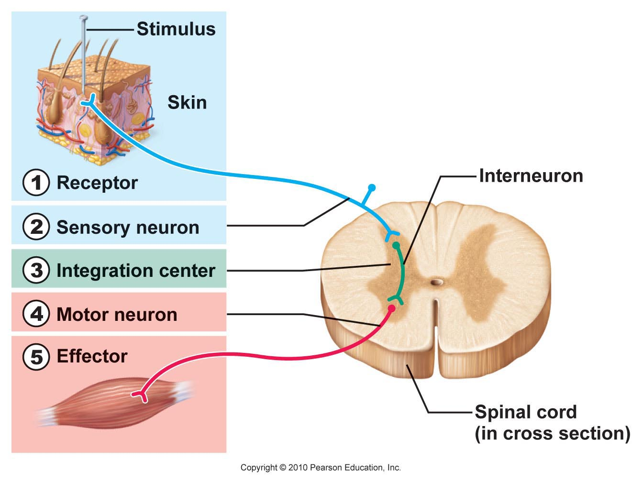
Neuron types: Sensory, Interneurons, Motor

Slide 32
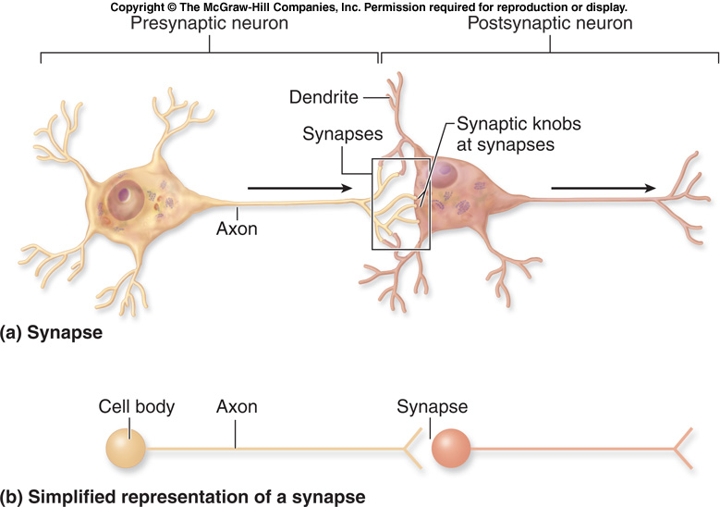
Neuron Organization

Slide 33
Checkpoint Questions
1. What are the functions of the cell body, axon and dendrites?
2. Which cells produce the myelin sheath?
3. What are the differences between neurons and neuroglial cells?
4. Why does white matter appear white? Where in the brain and spinal cord is it found?

Slide 34
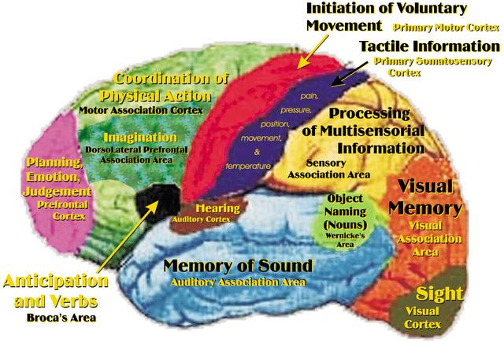
Central Nervous System
Integrates and correlates incoming sensory information
Source of thoughts, emotions and memories

Slide 35
Structure of the Peripheral Nervous System
Somatic Nervous System (SNS)
Relays sensory information from the receptors in the head, body wall, limbs and special sense receptors to the CNS
Relays motor information from CNS to skeletal muscles only
Voluntary

Slide 36
Structure of the Peripheral Nervous System
Autonomic Nervous System (ANS)
Relays sensory information from organs to the CNS
Relays motor information from CNS to smooth muscle, cardiac muscle and glands (involuntary)
ANS is divided into the sympathetic and parasympathetic divisions

Slide 37
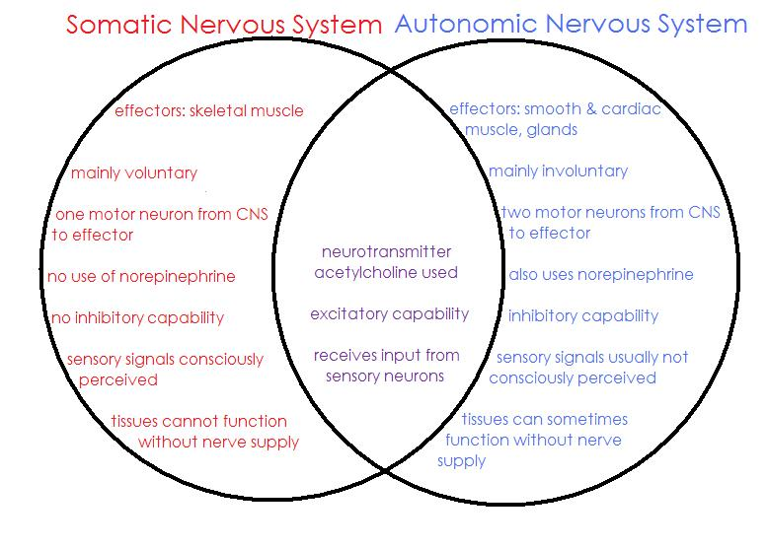

Slide 38
Structure of the Peripheral Nervous System
Sympathetic
generally speeds up body function
“fight or flight”
Parasympathetic
generally slows down body function
“rest and digest”

Slide 39
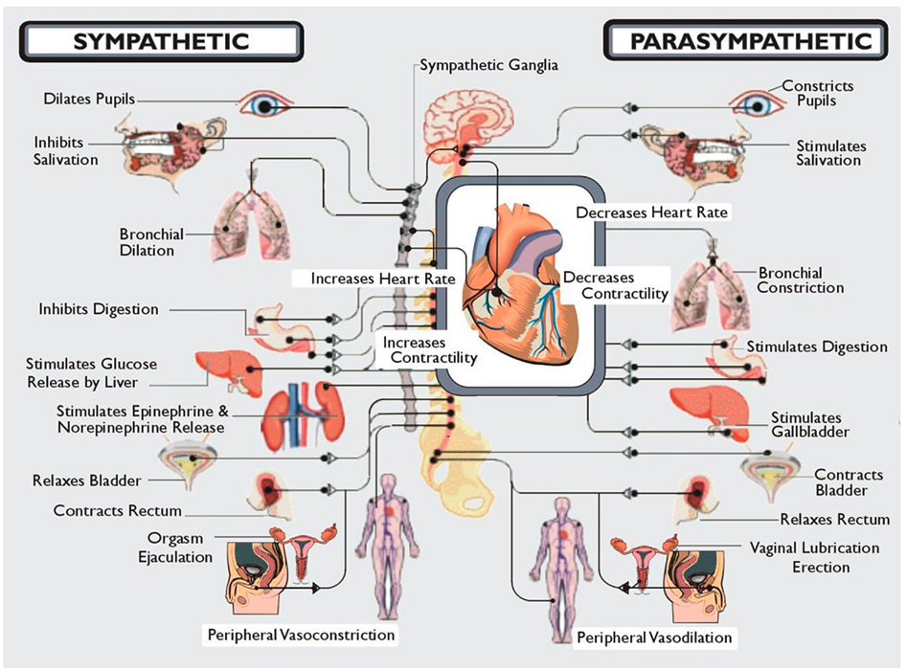

Slide 40
Structure of the Peripheral Nervous System
Enteric Nervous System (enter/o= small intestine)
“Brain of the Gut”
Sensory neurons monitor chemical changes within the GI tract and the stretching of the walls
Motor neurons control contraction of smooth muscle and secretions of the GI tract cells.

Slide 41
Check point
What types of structures can neurons have?
What types of neurons are there?
3. What is an Action Potential?

Slide 42
Action Potentials
Objective
Describe how a nerve impulse is generated and conducted.
Describe saltatory and continuous conduction.
Explain what occurs during each phase of an action potential

Slide 43
Action Potential Vocab
Action Potential = nerve impulse
Resting Membrane Potential: a difference in electrical charge inside and outside the cell
Ion Channel: membrane proteins that allow for the transport of charged atoms

Slide 44
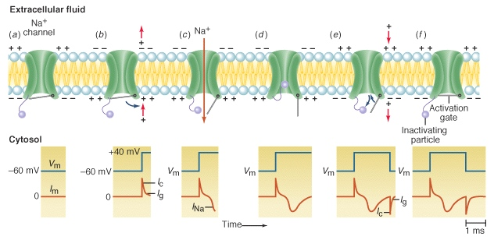
Ion Channels
As ions diffuse across the membrane, they equalize the charges on either side of the membrane, resulting in a change in membrane potential.

Slide 45
Ion Channels
Leakage Channels - allow a slow, steady stream of ions to diffuse across the membrane.
Gated Channels - open and close in response to a stimulus
Voltage gated channels - channels that open in response to a change in membrane potential

Slide 46
Resting Membrane Potential
In a resting neuron, the outside surface of the plasma membrane has a positive charge and the inside has a negative charge. This difference in charge is a form of potential energy that can be measured in volts. The resting membrane potential for a neuron is -70mV

Slide 47
Neuron at Resting Potential
Membrane is polarized (charged!)
-70mv inside cell
Inside more negative than outside.
What keeps it neg?
Large, negative proteins, chloride ions, and nucleic acids inside.
Leaky membrane allows Na+ and K+ ions to diffuse, so Na/K pump is always working.

Slide 48
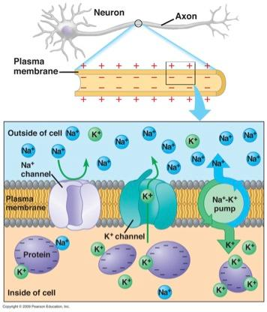
Resting Membrane Potential

Slide 49
Maintaining Resting Membrane Potential
Interstitial Fluid - high [Na⁺] and [Cl⁻]
Cytosol - high [K⁺] and [PO⁻]
Because there are more K⁺ leakage channels, more K⁺ exits than Na⁺ enters. Cl⁻ can enter the cell but PO⁻ cannot exit because it is attached to other chemicals (Like ATP)

Slide 50
Na/K pump
Since Na+ and K+ continuously diffuse across the membrane, they must be pumped back against the concentration gradient to maintain membrane potential.

Slide 51
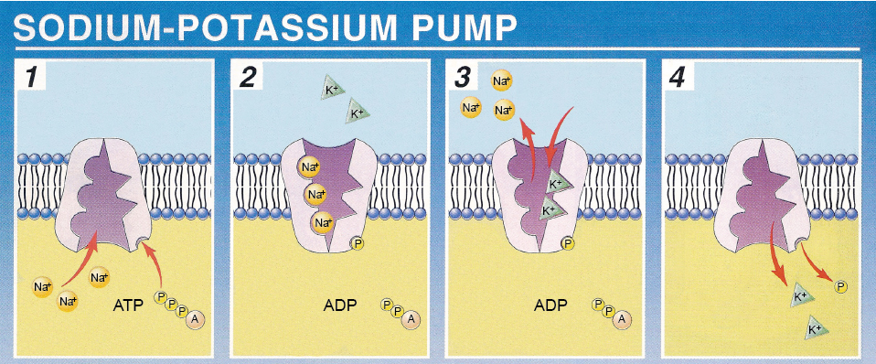

Slide 52
Generation of Action Potentials
Action Potential/ Nerve Impulse - a sequence of rapidly occurring events that decrease and reverse membrane potential and then restore it to its resting state.

Slide 53
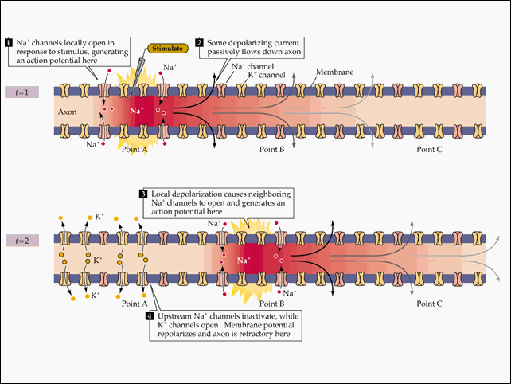

Slide 54
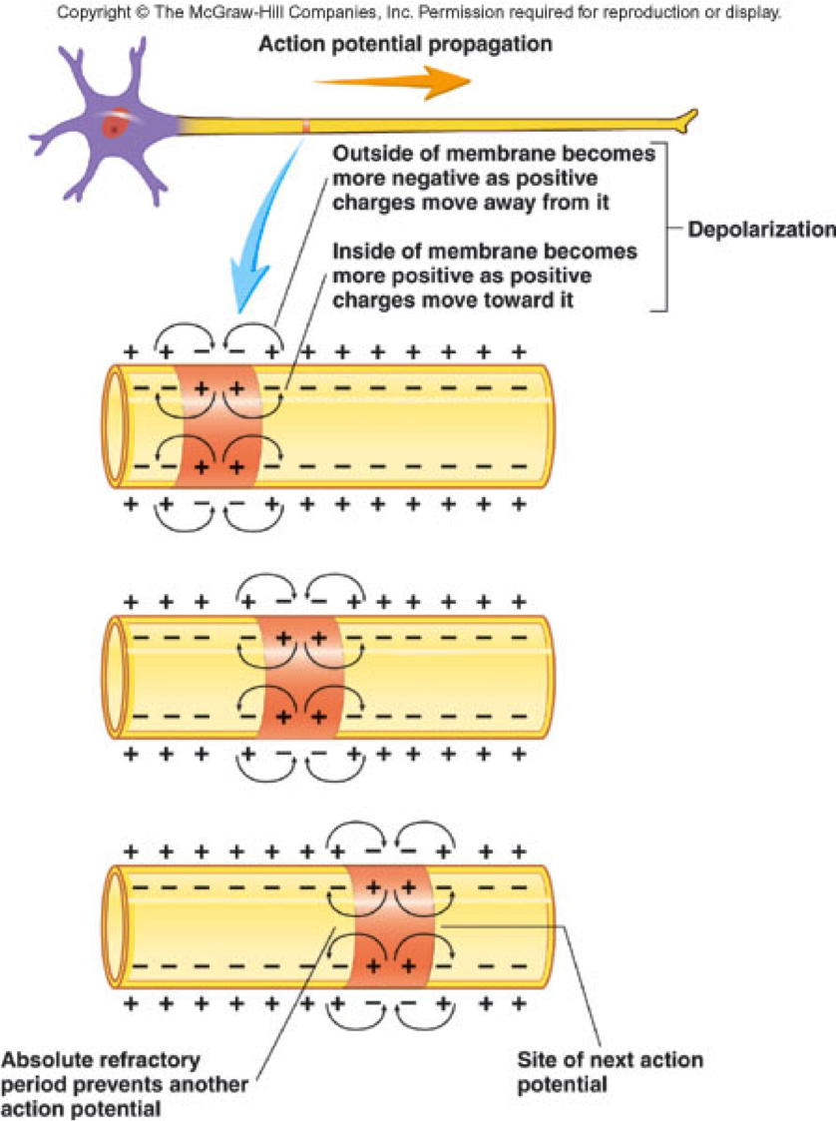
Phases of a Membrane Potential
1. Depolarizing - the polarization is decreased and reversed
2. Repolarizing - membrane polarization is returned to resting state.

Slide 55
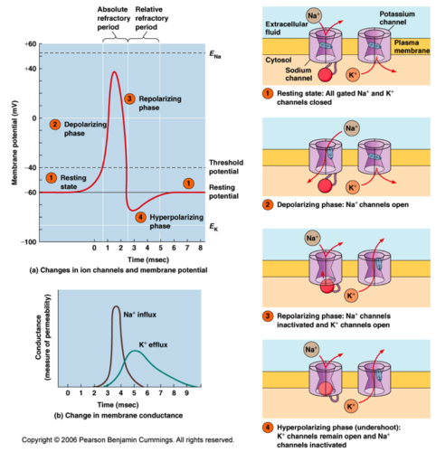
Hyperpolarizing Phase - outflow of K+ is large enough to cause the membrane potential to become even more negative than resting membrane potential
Wait, what’s this?

Slide 56
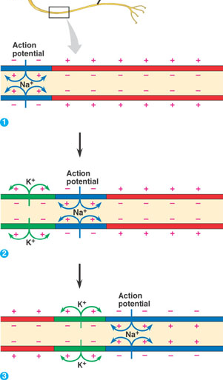
Moving Action Potential
Action potentials are pulse-like waves of voltage.
Diffusion and electrochemical attraction move ions in/out
Myelinated axons increase speed of action potential.
Animation
Animation 2

Slide 57
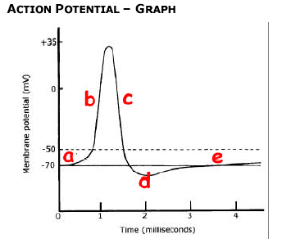
Moving Impulse Along Neuron
a. Resting potential = -70mv
b. Depolarization – reversal of charges
1. Na+ gates open and enters cell
2. Potential changes to = +35mv
c. Repolarization – reversal of charges to restore resting pot.
1. Na+ gates shut
2. K+ gates open and leaves cell
d. Hyperpolarization –
1. Too much K+ moved out than was necessary
e. Refractory period – Fixing overcorrection with active transport. Cannot respond to another stimulus.
1. Na/K+ pumps move Na+ out and K+ into cell to re-establish polarity
Animation
Animation 2
Animation 3

Slide 58
Check Point- Action Potentials
1. What is a resting membrane potential?
2. What are the phases of an Action Potential?
3. What is a sodium potassium pump? What type of transport is this characterized as?

Slide 59
All or None Principle
As long as a stimulus is strong enough to cause depolarization to reach threshold, then an action potential will occur - a stronger stimulus will not cause a larger action potential.

Slide 60
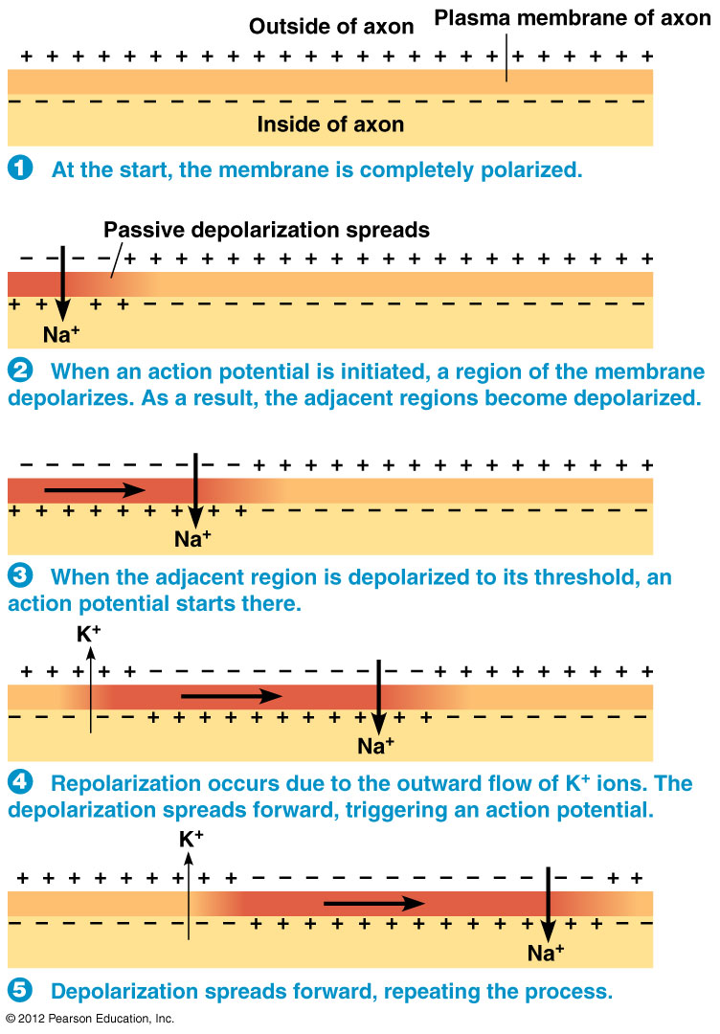
Conduction of Nerve Impulses
Works by positive feedback
Depolarization opens voltage gated Na+ channels
Inflow of Na+ depolarizes the adjacent membrane
Causes more Na+ channels to open
More Na+ enters, more channels open, more Na+ enters…

Slide 61
Types of Conduction
Continuous Conduction - occurs in unmyelinated axons. Depolarization has to occur all the way down the axon
Saltatory Conduction - occurs in myelinated axons. Depolarization only occurs at Nodes of Ranvier.

Slide 62
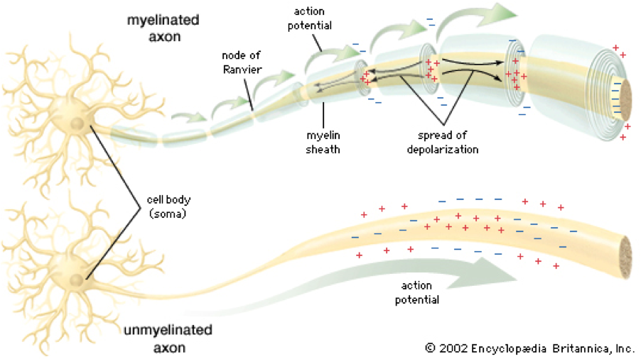

Slide 63
Factors affecting speed of nerve impulses
Myelination - Myelinated axons conduct faster
Diameter - Large diameter conduct faster
Temperature - Warm conducts faster

Slide 64
Checkpoint Questions
1. What is membrane potential?
2. What happens during depolarization?
3. What 2 membrane structures allow for the movement of ions?
4. What is the difference between continuous and saltatory conduction?
5. What factors affect the speed of nerve impulses?

Slide 65
Synaptic Transmission
Objectives:
Describe the events that occur at a synapse
Describe the effect of various neurotransmitters (ACh, glutamate, aspartate, GABA, glycine, NE, DA, serotonin, endorphins)

Slide 66
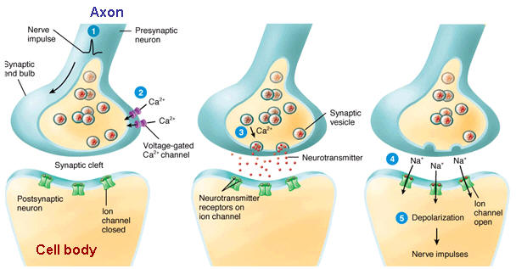
Synaptic Vocab
Synaptic Cleft - tiny space filled with interstitial fluid between neurons
Presynaptic Neuron - the neuron sending a signal
Postsynaptic Neuron - the neuron receiving the message
Neurotransmitter - chemical released by neurons to communicate with other cells

Slide 67
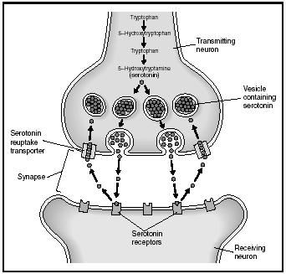
Synapse
Neurotransmitters: communication chemicals (50+ types known!)
Threshold – minimum amount of stimulus needed for depolarization.
Reuptake transporters recycle neurotransmitters.
Animation
Neuron Communication Video

Slide 69
Events at a Synapse
1. A nerve impulse arrives at a synaptic end bulb of a presynaptic axon
2. The depolarization phase of the nerve impulse opens voltage gated Ca²⁺ channels, Ca²⁺ flows into the synaptic end bulb through the opened channels

Slide 70
3. An increase in [Ca²⁺] inside the synaptic end bulb triggers exocytosis of some synaptic vesicles which release neurotransmitters.

Slide 71
4. The neurotransmitters diffuse across the synapse and bind to neurotransmitter receptors. Binding opens ion channels allowing certain ions to flow across the membrane
5. As ions flow through the channel, the voltage across the membrane changes

Slide 72
Neurotransmitters
Excitatory – Increases activity of postsynaptic neuron.
Inhibitory – Decreases activity of postsynaptic neuron.
More than one type of neurotransmitter can be released by a single neuron and one neuron can have synapses with several different neurons (convergence and divergence), thus, a single neuron can have receptors for many different types of neurotransmitters.

Slide 73
Common Neurotransmitters
Acetylcholine – Excitatory, skeletal muscle contraction
Norepinephrine – Excitatory; increase HR.
GABA – Inhibitory, reduces anxiety.
Glutamate – Excitatory, involved in learning and memory.
Endorphins – Inhibitory, natural opiates.
Serotonin – Involved in regulating attention, emotions, mood disorders
Dopamine – Contributes in voluntary movement; feel good emotions, Parkinson’s

Slide 74
Check Point
Give a brief description of how a synapse works, include the involvement of Ca+

Slide 75
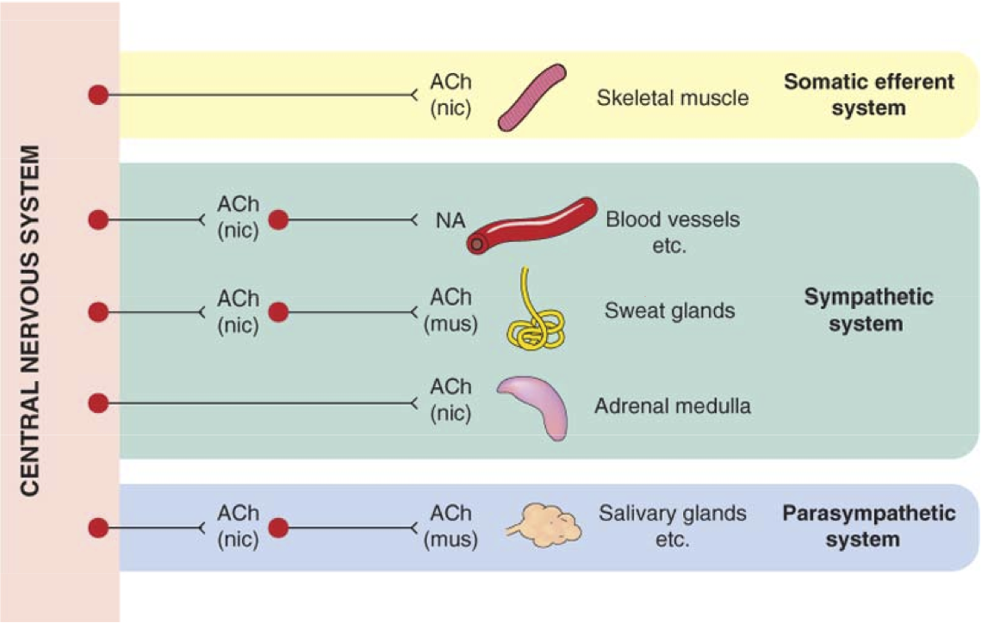
Acetylcholine (ACh)
Excitatory neurotransmitter at the neuromuscular junction.
Inhibitory at other synapses (slows heart rate when released by PNS).

Slide 76
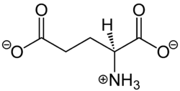
Glutamate and Aspartate
Amino Acids that have an excitatory effect on the CNS

Slide 77
GABA and Glycine
Inhibitory Neurotransmitters
Anti-anxiety drugs often enhance these neurotransmitters

Slide 78
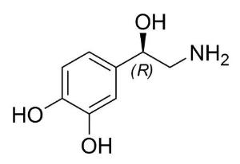
Norepinephrine
Functions in awakening, dreaming and mood

Slide 79
Dopamine (DA)
Active during emotional response and addictive behavior
Cocaine blocks the re-uptake of dopamine allowing it to stay in the synaptic cleft longer and prolonging pleasurable feelings

Slide 80
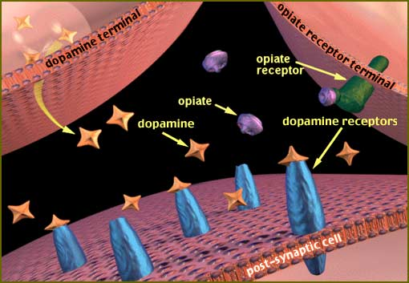

Slide 81
Removal of Neurotransmitters
A neurotransmitter affects the postsynaptic cell as long as it remains bound - so it is essential that it be removed.
Diffuse away
Destroyed by enzymes
Actively transported into another cell

Slide 82
Endorphins
Natural Pain Killers
Endorphins interact with the opiate receptors in the brain to reduce our perception of pain and act similarly to drugs such as morphine and codeine. In contrast to the opiate drugs, however, activation of the opiate receptors by the body's endorphins does not lead to addiction or dependence.

Slide 83
Drug Effects on Neurotransmitters
Pain killers – stop the release or block receptor sites or increase threshold.
Caffeine – lowers threshold at synapses so neurons are more easily excited.
Zoloft/Prozac/Paxil– keeps serotonin in the synapse longer; anti-depressants
Dilantin – increasing effectiveness of ion transport; treats seizures
Go to Mouse Party for the affects of illegal drugs on neurotransmitters…

Slide 84
Check point
In your notes write this down! (Hint***)
1. Name 2 neurotransmitters and what they are responsible for in our body
2. Explain how an action potential works use detail

